Slide 1

Liquid crystals
Χαχλάκη Ελπινίκη
ΑΜ:1015
Υπερμοριακή Χημεία
Υπεύθυνος Καθηγητής: κ.Αθανάσιος Κουτσολέλος

Slide 2
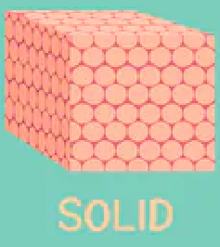
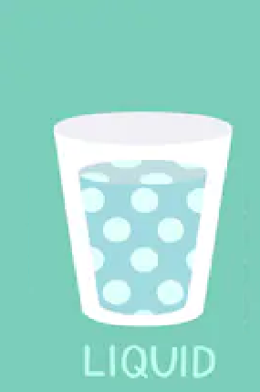
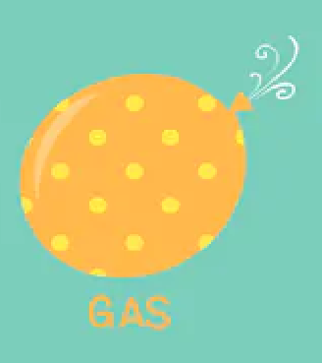
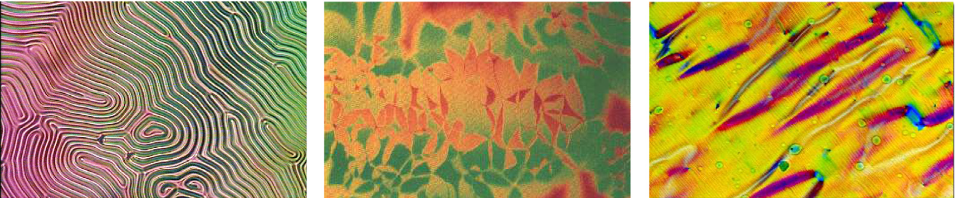
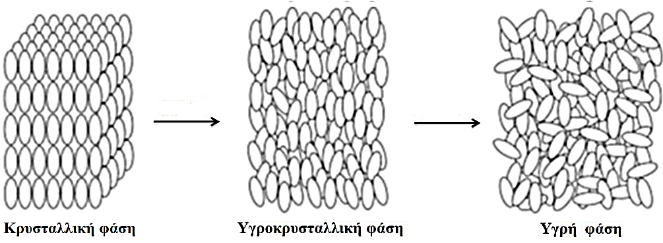
What is it?
LIQUID CRYSTAL
Μαρία Κουή (2017). Υγροί κρύσταλλοι: Η μεσόμορφη κατάσταση της ύλης, 1-195.

Slide 3
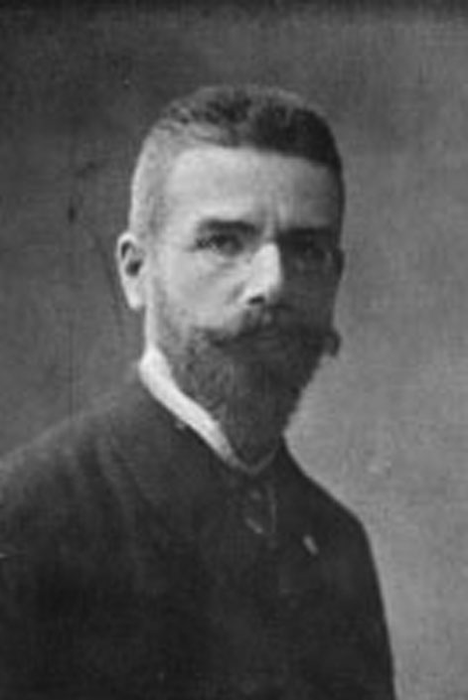

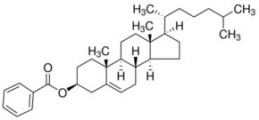
History of liquid crystals
1888 Friedrich Reinitzer
1890 Otto Lehmann
1904 Merck
www.merckgroup.com/en
“Liquid Crystal Phase”
Mitov, M. (2014). Liquid-crystal science from 1888 to 1922: Building a revolution. ChemPhysChem, 15(7), 1245–1250.

Slide 4
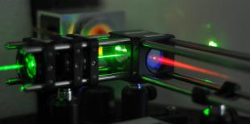



History of liquid crystals
1962 Laser
1965 LCD Screens
Uni.Edinburgh www.eng.ed.ac.uk/liquid-crystal-lasers
B. Hogan, E. Kovalska, M. F. C. and A. B. (2018). 2D material liquid crystals for optoelectronics and photonics. Proceedings - International Conference Laser Optics 2018, ICLO 2018, 194.

Slide 5
Classifications of liquid crystals
LIQUID CRYSTALS
Thermotropic
Lyotropic
Metallotropic

Slide 6
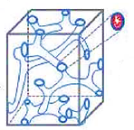
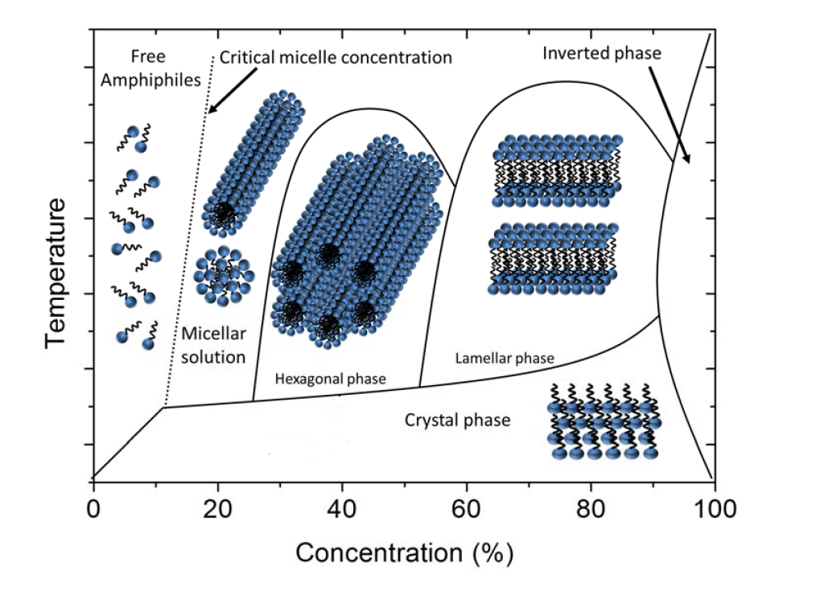

Lyotropic liquid crystals
Depend on:
Concertation of constituents
Temperature
Dierking, I., & Al-Zangana, S. (2017). Lyotropic Liquid Crystal Phases from Anisotropic Nanomaterials. Nanomaterials, 7(10), 305.

Slide 7
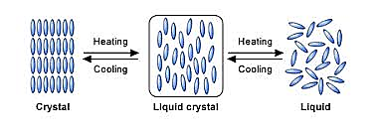
Thermotropic liquid crystals
Classes
Depend on :
Temperature
Pressure
Columnar
Nematics
Cholesterics
Smectics

Slide 8
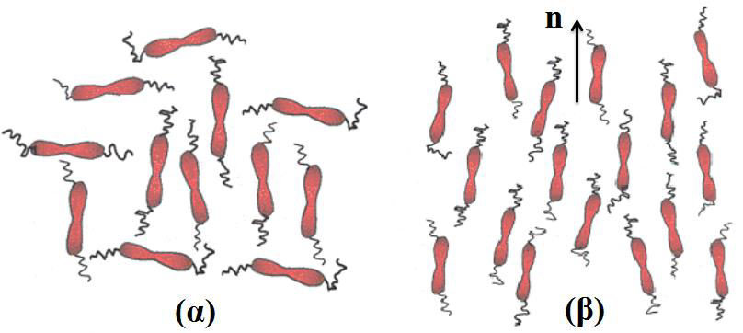
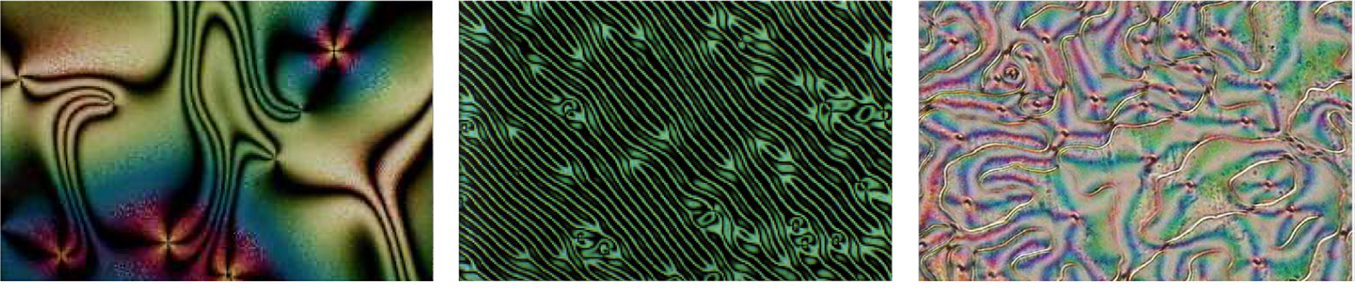
Nematics
Μαρία Κουή (2017). Υγροί κρύσταλλοι: Η μεσόμορφη κατάσταση της ύλης, 1-195.
α) Molecules in liquid phase b) Molecules in liquid crystal nematic phase
Andrienko, D. (2018). Introduction to liquid crystals. Journal of Molecular Liquids, 267, 520–541.

Slide 9
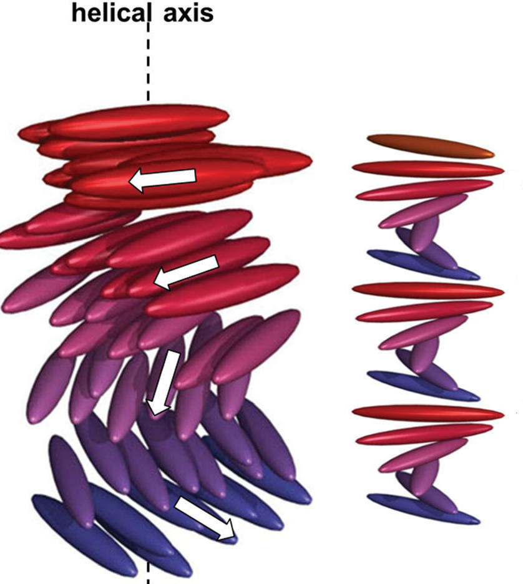
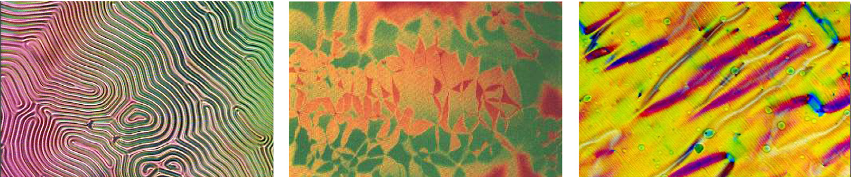
Cholesterics
Mitov, M. (2017). Cholesteric liquid crystals in living matter. Soft Matter, 13(23), 4176–4209
Andrienko, D. (2018). Introduction to liquid crystals. Journal of Molecular Liquids, 267, 520–541.

Slide 10
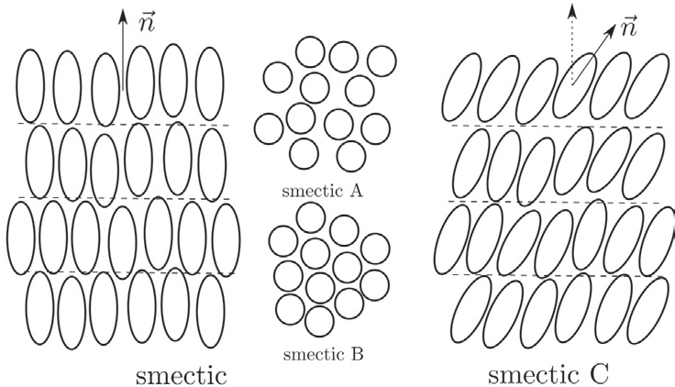
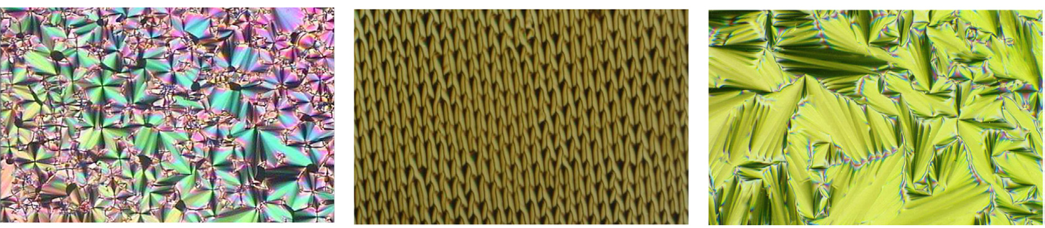
Smectics
Andrienko, D. (2018). Introduction to liquid crystals. Journal of Molecular Liquids, 267, 520–541.

Slide 11
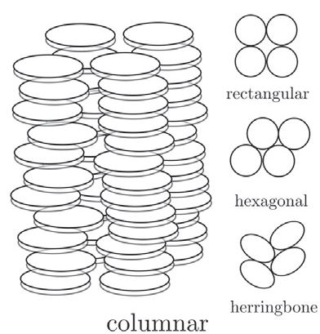
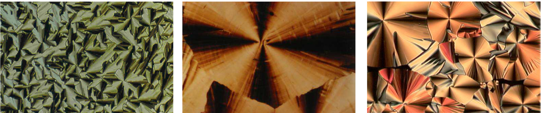
Columnar
Andrienko, D. (2018). Introduction to liquid crystals. Journal of Molecular Liquids, 267, 520–541.

Slide 12
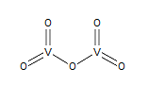
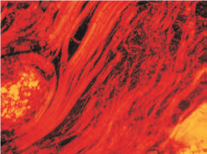
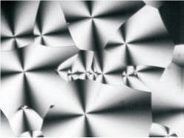
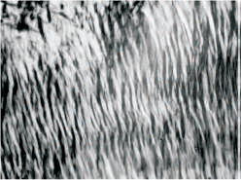
Metallotropic liquid crystals
Lamellar
Cubic
Hexagonal
1925
decomposed
Metal oxides
before the melting point
ZnCl2 (290 ºC) CuCl2 (630ºC) CdCl2 (568ºC)
Martin, J. D., Keary, C. L., Thornton, T. A., Novotnak, M. P., Knutson, J. W., & Folmer, J. C. W. (2006). Metallotropic liquid crystals formed by surfactant templating of molten metal halides. Nature Materials, 5(4), 271–275.

Slide 13
Polarized Light microscope
Optical anisotropy materials
Absorbance
Refraction
Scattering
depend on the
Orientation of the material
Oldenbourg, R. (2013). Polarized light microscopy: Principles and practice. Cold Spring Harbor Protocols, (11), 1023–1036.

Slide 14
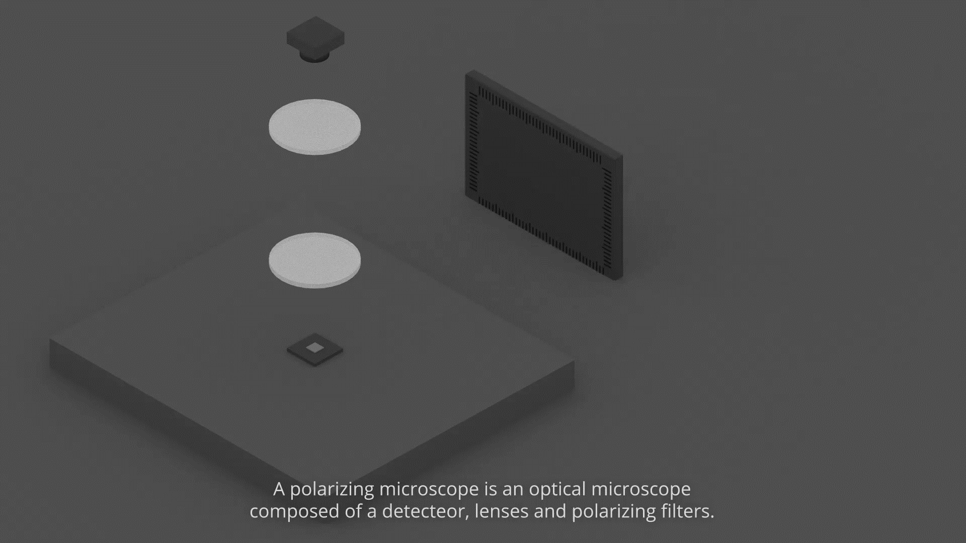
Polarized Light microscope
www.toutestquantique.fr/en/microscopy

Slide 15
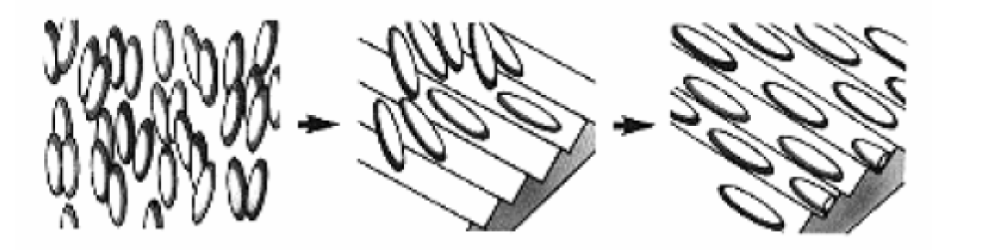
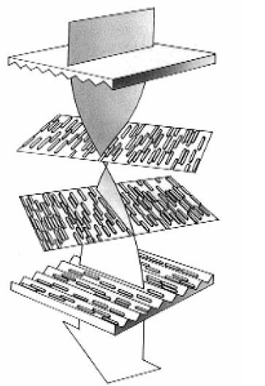
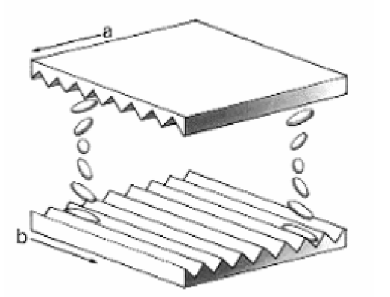
Applications:
Liquid crystal display(LCd)
Jeremy Gurski & Lee Ming Quach Date (2005). Display Technology Overview, Lytica, 1-35.

Slide 16
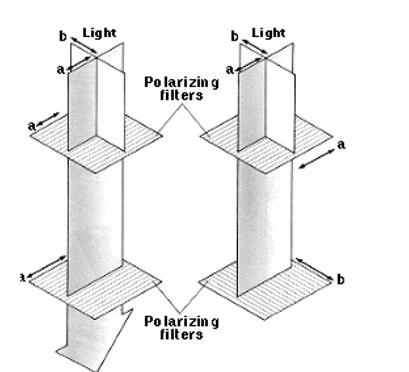
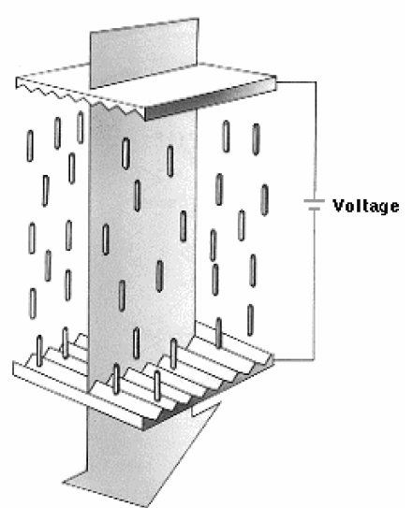
Applications:
Liquid crystal display(LCd)
Jeremy Gurski & Lee Ming Quach Date (2005). Display Technology Overview, Lytica, 1-35.

Slide 17
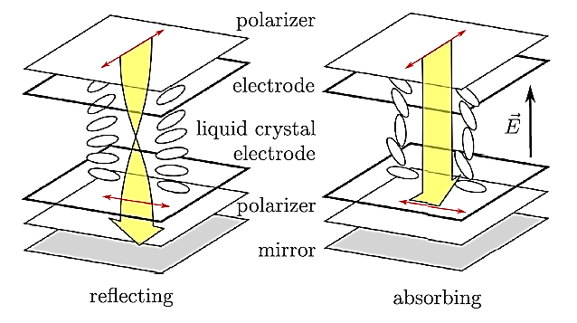
Applications:
Liquid crystal display(LCd)
Andrienko, D. (2018). Introduction to liquid crystals. Journal of Molecular Liquids, 267, 520–541.

Slide 18
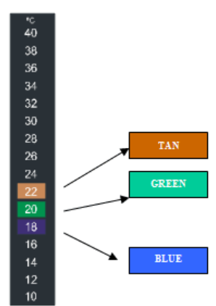
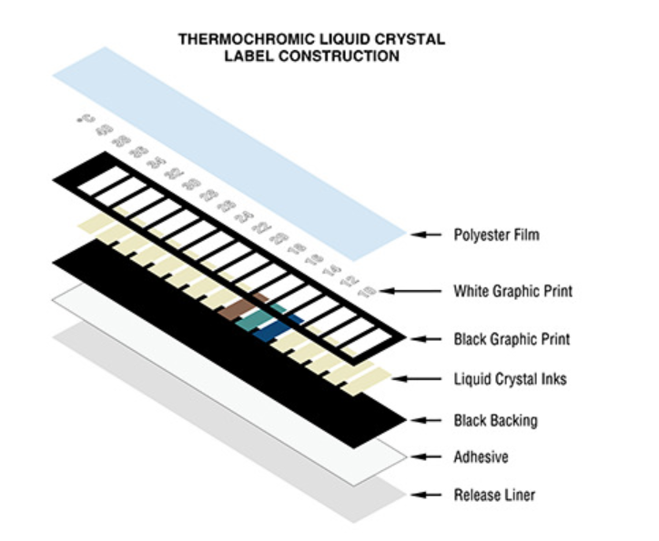
Applications:
Liquid crystal Thermometers

Slide 19


